Slide 1
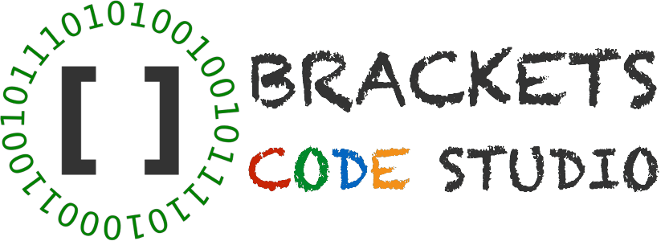
Introduction to Robotics
2016 Fall

Slide 2
Human – Robot Comparison
Type | Controller | Motor System | Sensory System
Human
Robot

Slide 3
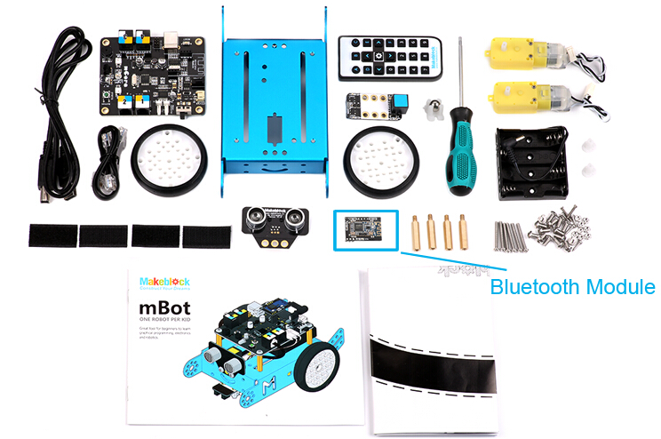
Arduino Micro Controller
mBot
Line Following Sensor
USB Cable
RJ25 Cable
Ultrasonic Sensor

Slide 4
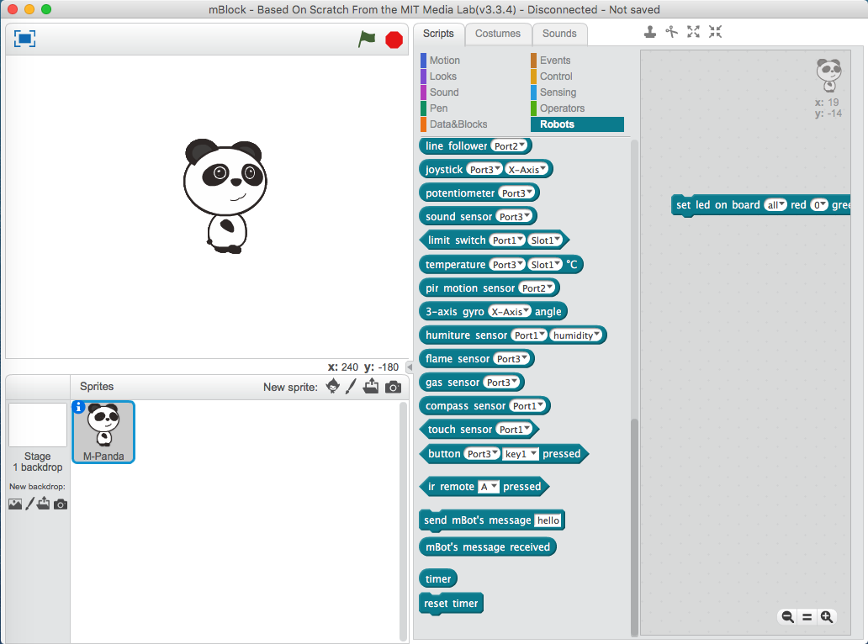
Mblock: must be connected to control mBot

Slide 5
Communication with mBot
Type | Device | Pro | Cons
IR | Remote | Easy | Interfere with other mBots
USB | Computer | Easy, one-2-one, no interfere | mBot must be physically connected
Bluetooth | Computer | one-2-one, no interfere, independent | Paring is required

Slide 6
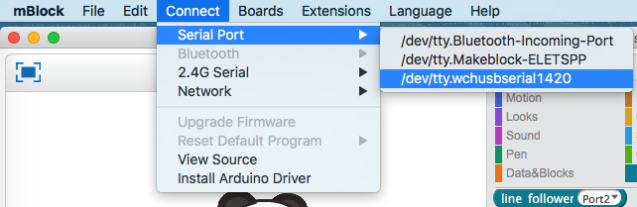
Connecting mBot with mBlock: USB
1. Turn off mBot
2. Plug USB cable to both mBot and the computer
3. Power on mBot
MAC:
PC: Connect → Serial Port → COM X, try different X to find the one that works

Slide 7

Connected Status

Slide 8
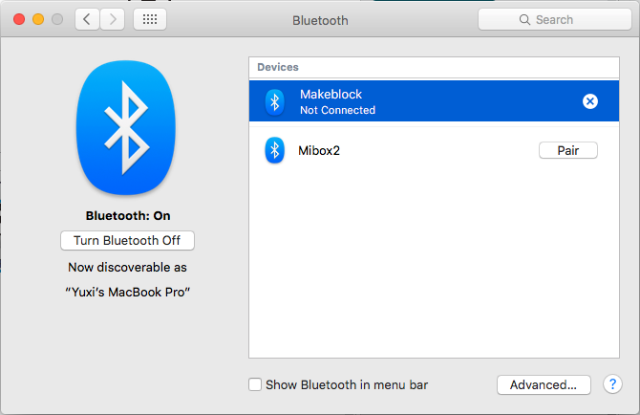
MAC 1: Better Way to Connecting mBot: Bluetooth
1. Turn off mBot
2. Power on mBot
3. Apple Logo → System Preferences → Bluetooth. Pair with Makeblock. Sometimes, it shows “Not Connected”, which is OK.
MAC:

Slide 9
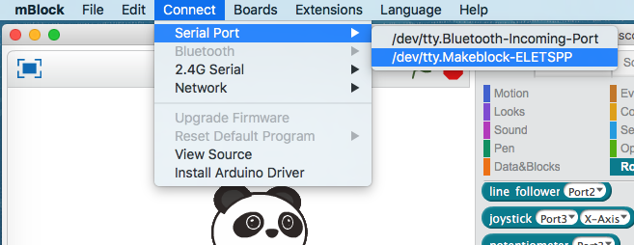
MAC 2: Better Way to Connecting mBot: Bluetooth
4. Connect
MAC:

Slide 10
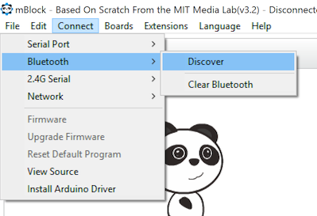
PC: Better Way to Connecting mBot: Bluetooth
1. Turn off mBot
2. Power on mBot
3. in mBlock, choose Connect->Bluetooth->Discover, select your device discovered in the list

Slide 11
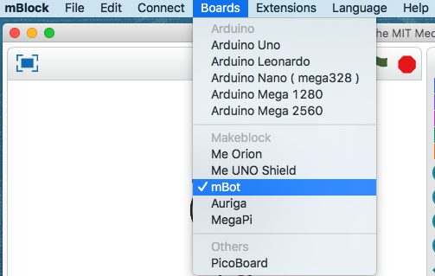
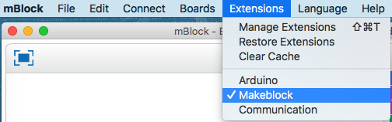
Make Sure Correct Board and Extension Have Been Selected
0
Mbot is selected
Makeblock extension is selected

Slide 12
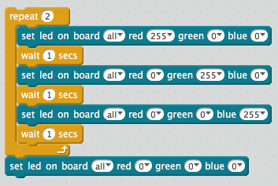
Experiment 1: LED on board
1. Make a new project
2. Save Project as LED.sb2 at Box Sync → [Your Name]
3. Use “set led on board” block
Challenge: display other colors like yellow, purple

Slide 13
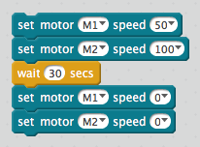
Experiment 1: Move along a circle
1. Make a new project
2. Save Project as circle.sb2 at Box Sync → [Your Name]
3. Use “set motor” block
Challenge: figure out the real speeds of 50, 100, 200 in inches per second

